Slide 1
RESEARCH PROPOSAL DRAFT

Slide 2
OVERVIEW
Title
HYDRO-MECHANIC MODELING OF THERMALLY INDUCED FRACTURES
Research question
Q1: How thermally induced fractures affect reservoir drainage, storage capacity and safety?
Hypotheses
H1: Thermally induced fracture dynamics affect reservoir drainage, fluid storage, and operational integrity.
H2: Natural fractures and rock failure in shear are mechanisms to release the strain energy resulting from thermal stresses
H3: Simple linear fracture transmissibility models using pressure and temperature as independent parameters are sufficient to capture the effective physical behavior needed to estimate reservoir drainage and fluid storage for most cases. However, the assessment of integrity needs to incorporate more complex physics.

Slide 3
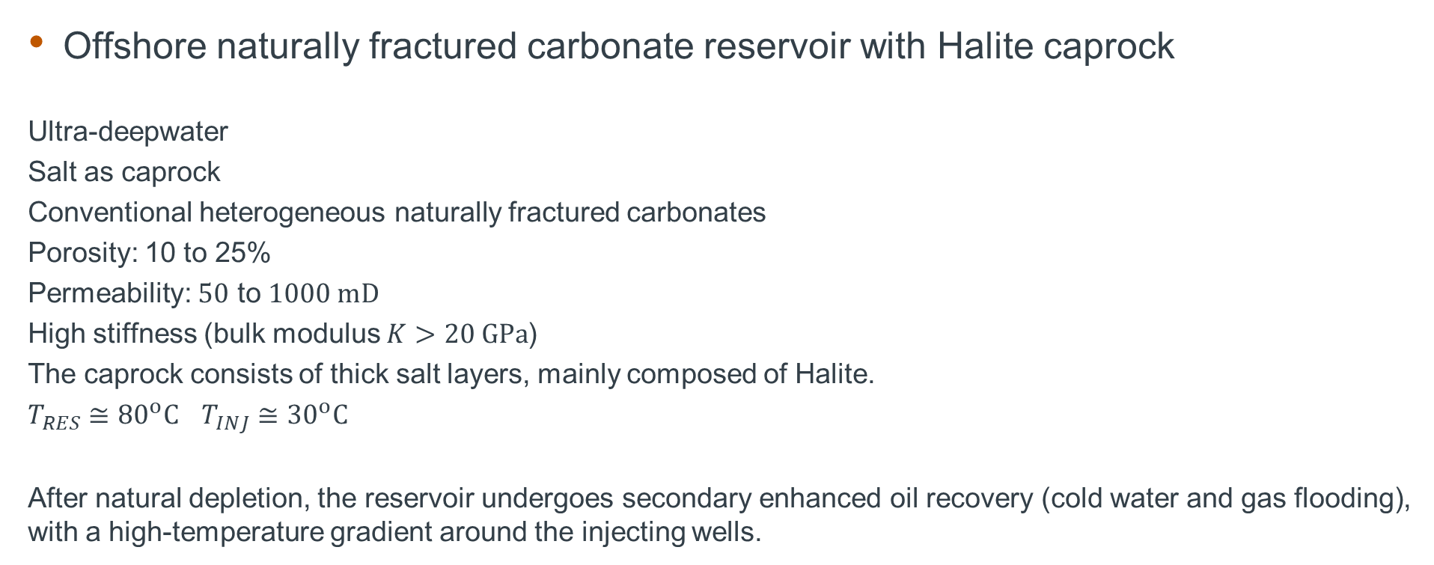
TARGET APPLICATION
Offshore naturally fractured carbonate reservoir with Halite caprock
Ultra-deepwater
Salt as caprock
Conventional heterogeneous naturally fractured carbonates
Porosity: 10 to 25%
Permeability: $50$ to $1000 mD$
High stiffness (bulk modulus $K>20 GPa$)
The caprock consists of thick salt layers, mainly composed of Halite.
$T_{RES}≅{80}^{o}C$ $T_{INJ}≅{30}^{o}C$
After natural depletion, the reservoir undergoes secondary enhanced oil recovery (cold water and gas flooding), with a high-temperature gradient around the injecting wells.

Slide 4
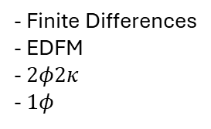
Methodology
Mechanics
Stress
Global mechanics
(U_{i})
Hydraulic
(P, S_{w}, S_{o}, S_{g})
P
- Finite Element
- Smeared
- Finite Differences
- EDFM
- $2φ2κ$
- $1φ$
Bound. Cond.
Fracture
Plasticity
(P, U_{i})
Effective params
T
P
Fracture propagation
(P, U_{i})
T
Thermal
(T)
- Finite Element
- Smeared
- Discrete
- Finite Differences

Slide 5
Timeline
Year/sem
2024/1 | EDFM Review Define research scope. Homogenization of Biot parameters
2024/2 | Literature review. Write and defend the proposal. Stress assessment. Multiphase flow in NFRs (side project) Application: estimate the effect of thermal stresses
2025/1 | Discrete fracture propagation. Integration with EDFM and finite difference simulators Fracture initiation and propagation. Application: heterogeneous media and branching
2025/2 | Plasticity and creep Application: fracture propagation in salt rock (caprock and caverns)
2026/1 | ...
2026/2 | Wrap up results.
2027/1 | Write dissertation.

